Slide 1
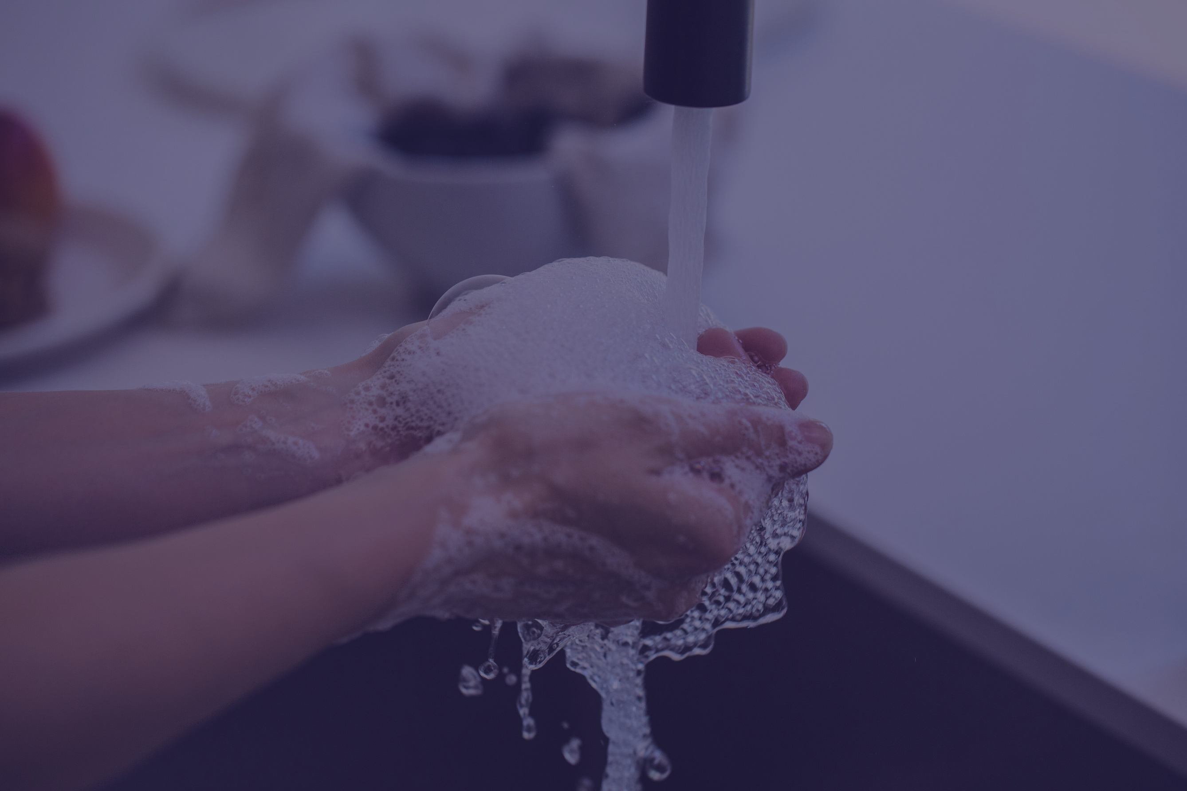

Hand
Washing
A Comprehensive Teaching Aid for Health Care NC II Students

Slide 2
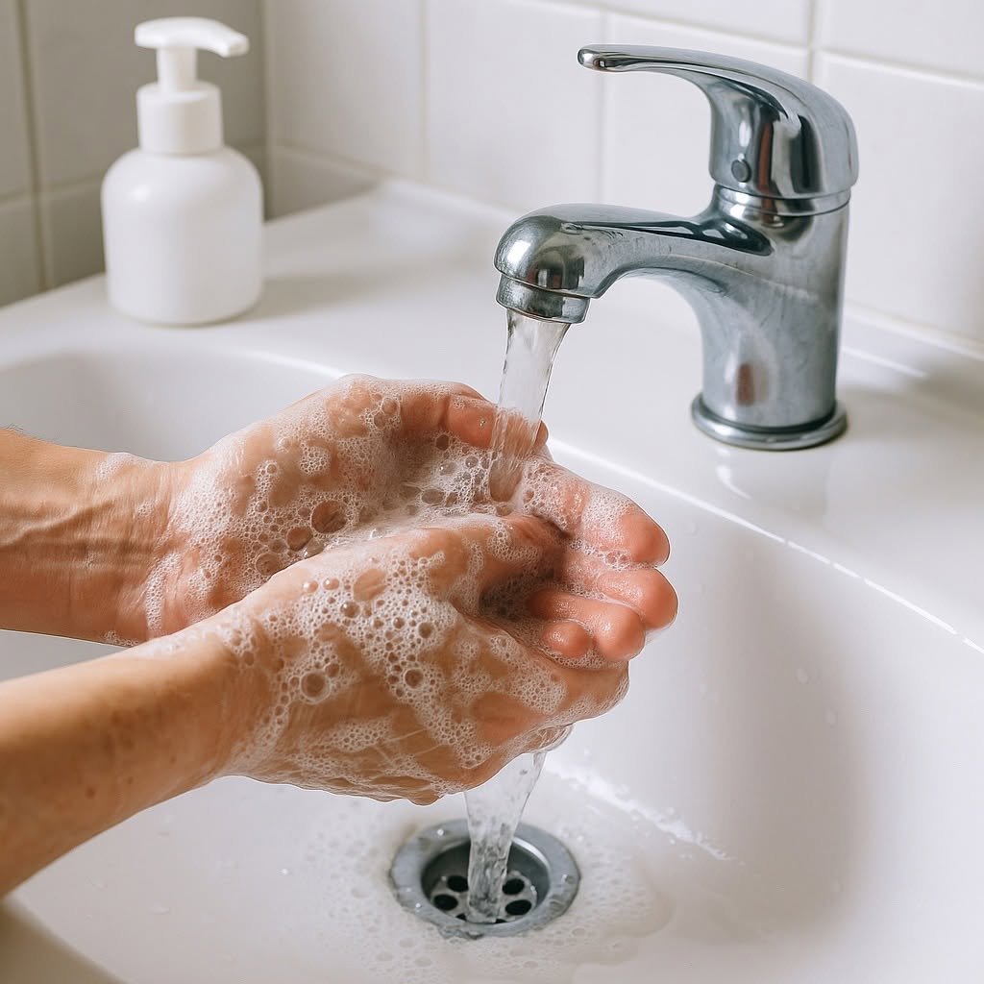


CONTENT PAGE
CHAPTER 1: Introduction to Handwashing
01
CHAPTER 2: Importance and Purpose of Hand Washing
02
CHAPTER 3: Types of Hand Hygiene
03
TABLE OF CONTENT
CHAPTER 4: Equipment needed for Hand Washing
04
CHAPTER 5: Medical Hand Washing Procedure
05-06
CHAPTER 6: Common Mistakes in Hand Washing
07
CHAPTER 7: Indications of Hand Washing
08
CHAPTER 8: QUIZ-Test your knowledge
09

Slide 3

CHAPTER 1: INTRODUCTION TO HAND WASHING
Hand washing is one of the most fundamental procedures in health care settings. It serves
as the first line of defense in preventing the spread of infections, especially in environments
where patients are vulnerable.
Proper hand hygiene is a critical component of infection control practices, aiming to
eliminate transient microorganisms and reduce the presence of resident flora
Page 1

Slide 4

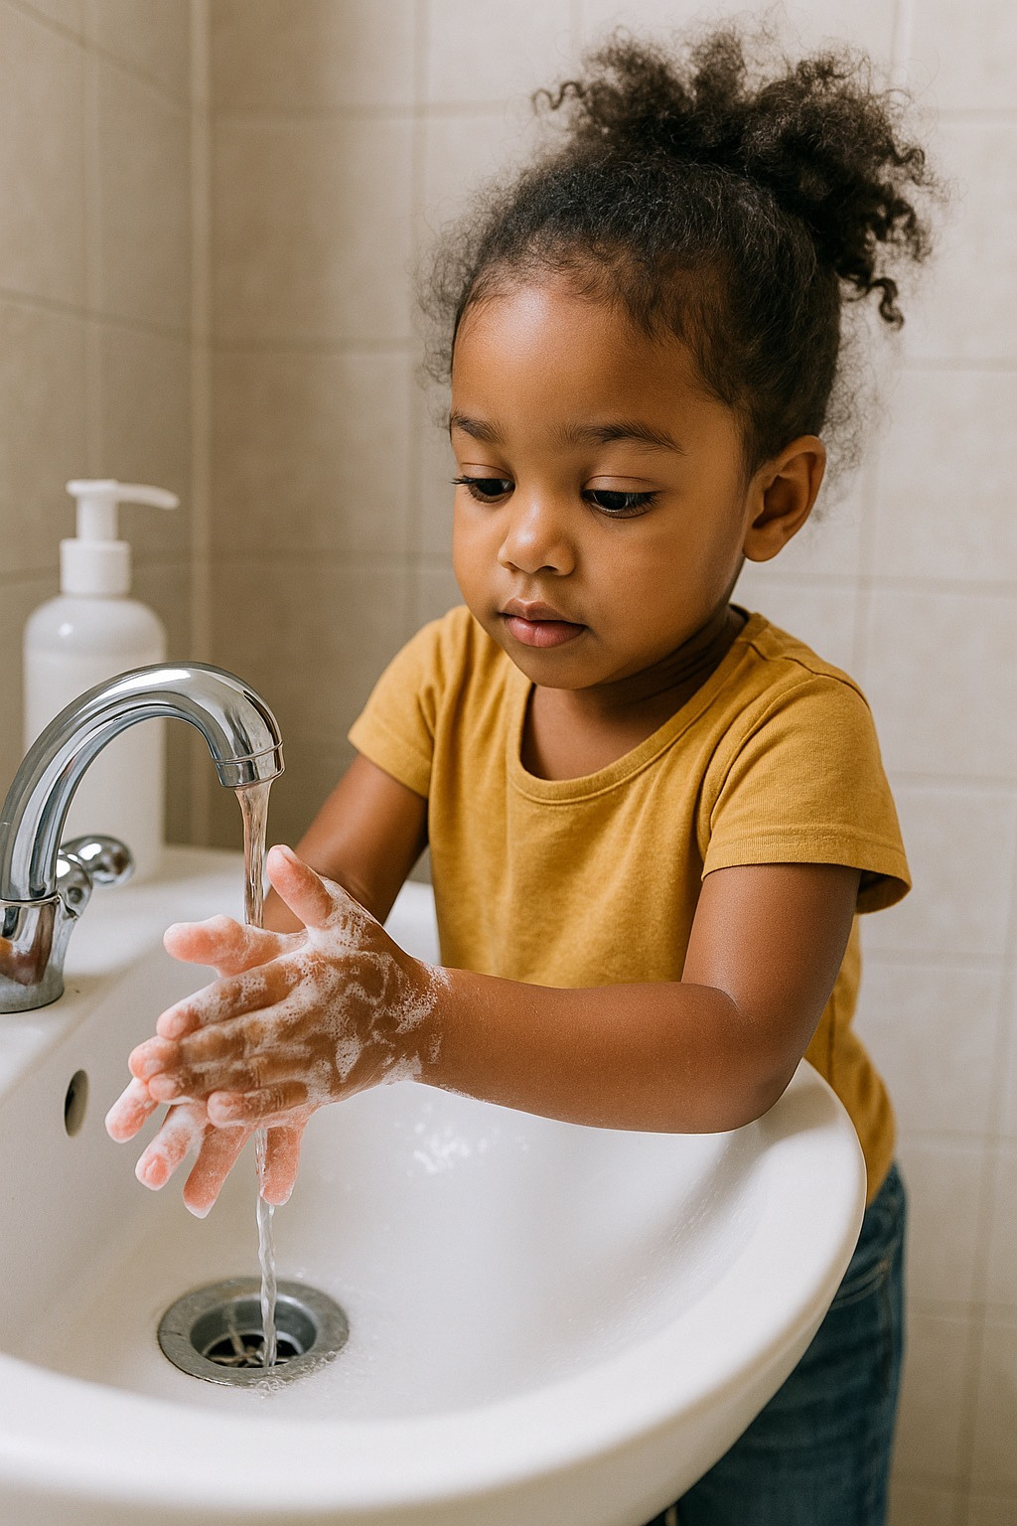

CHAPTER 2:
Importance and Purpose of Hand Washing
Hand washing is vital not only for protecting patients but also for the safety of health care
workers and the public. The primary purposes of proper hand washing are:
To remove dirt, organic material, and transient microorganisms.
To minimize the risk of transmitting infectious agents between individuals.
To protect health care workers from acquiring infections.
To prevent contamination of the health care environment
Page 2

Slide 5

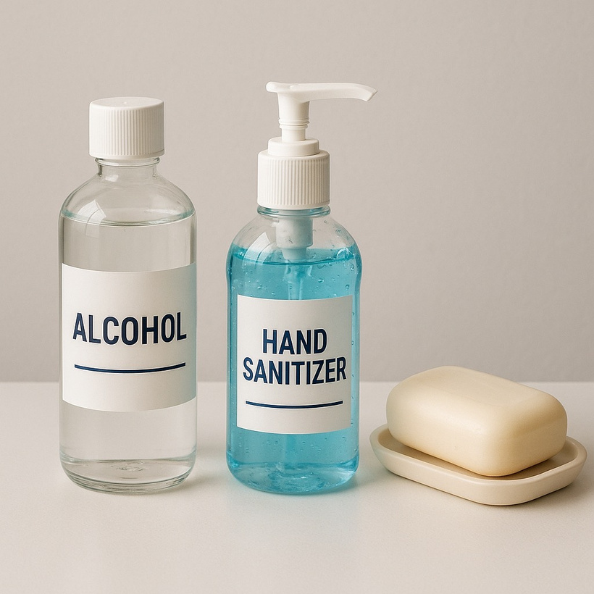
CHAPTER 3:
TYPES OF HAND HYGIENE
There are several types of hand hygiene used in health care settings, depending on the
situation and level of contamination:
ROUTINE (SOCIAL) HAND WASHING
ANTISEPTIC HAND WASHING
ALCOHOL-BASED HAND RUB
SURGICAL HAND ANTISEPSIS
Uses plain soap and water. Performed before and
after routine patient care.
Uses antimicrobial soap. Performed before invasive
procedures or when caring for high-risk patients.
Used when hands are not visibly soiled. Provides rapid
microbial kill.
Required before surgical procedures to eliminate transient
and reduce resident flora.
Page 3

Slide 6
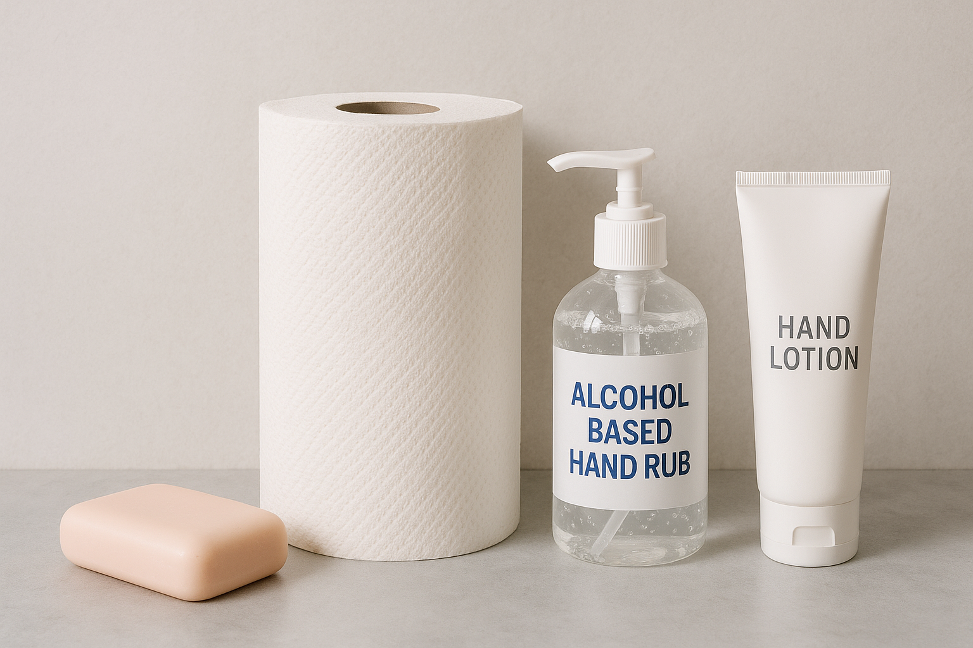
CHAPTER 4:
EQUIPMENT NEEDED FOR HAND WASHING
Proper hand washing requires the following materials:
Running water (preferably warm)
Soap (liquid or bar)
Paper towels or clean reusable towels
Alcohol-based hand rub (optional)
Hand lotion (optional to prevent skin dryness
Page 4

Slide 7
CHAPTER 5: MEDICAL HAND WASHING PROCEDURE
Presentation
ACTIONS
RATIONALE
1. Assess hands for cleanliness, wounds, or jewelry.
2. Prepare the area and materials. Make sure the sink is clean and accessible.
3. Turn on the faucet using wrist, elbow, or foot controls.
4. Adjust water temperature to warm.
5. Wet hands thoroughly, keeping hands lower than elbows.
6. Apply sufficient amount of soap and lather well.
Jewelry and open wounds may harbor microorganisms and increase risk of infection.
Ensures readiness and prevents contamination.
Avoids contaminating hands before washing.
Warm water is comfortable and promotes lathering without irritating the skin.
Water should flow from clean to dirty area, preventing contamination.
Soap lifts dirt and microorganisms from the skin.
Page 5

Slide 8
ACTIONS
Mechanical action is key to removing pathogens.
Time ensures complete removal of microorganisms.
Removes loosened dirt and soap residues.
Prevents chapping and removes remaining pathogens
Prevents recontamination from the faucet.
Maintains skin integrity and reduces dryness.
RATIONALE
7. Scrub all parts of the hands, including palms, back of hands, between fingers, and under nails.
8. Continue scrubbing for at least 20 seconds.
9. Rinse hands thoroughly under running water.
10. Dry hands using a clean paper towel.
11. Use paper towel to turn off faucet.
12. Apply hand lotion if desired.
Page 6

Slide 9


CHAPTER 6:
COMMON MISTAKES IN HAND WASHING
Even with regular practice, health care workers may make mistakes in hand hygiene. Some
of the most common errors include:
Not washing hands long enough (less than 20 seconds)
Missing key areas such as thumbs, fingertips, and between fingers
Using cold water which reduces soap effectiveness
Touching sink or faucet handles with clean hands
Not drying hands completely, leading to chapped skin and higher infection risk
Page 7

Slide 10
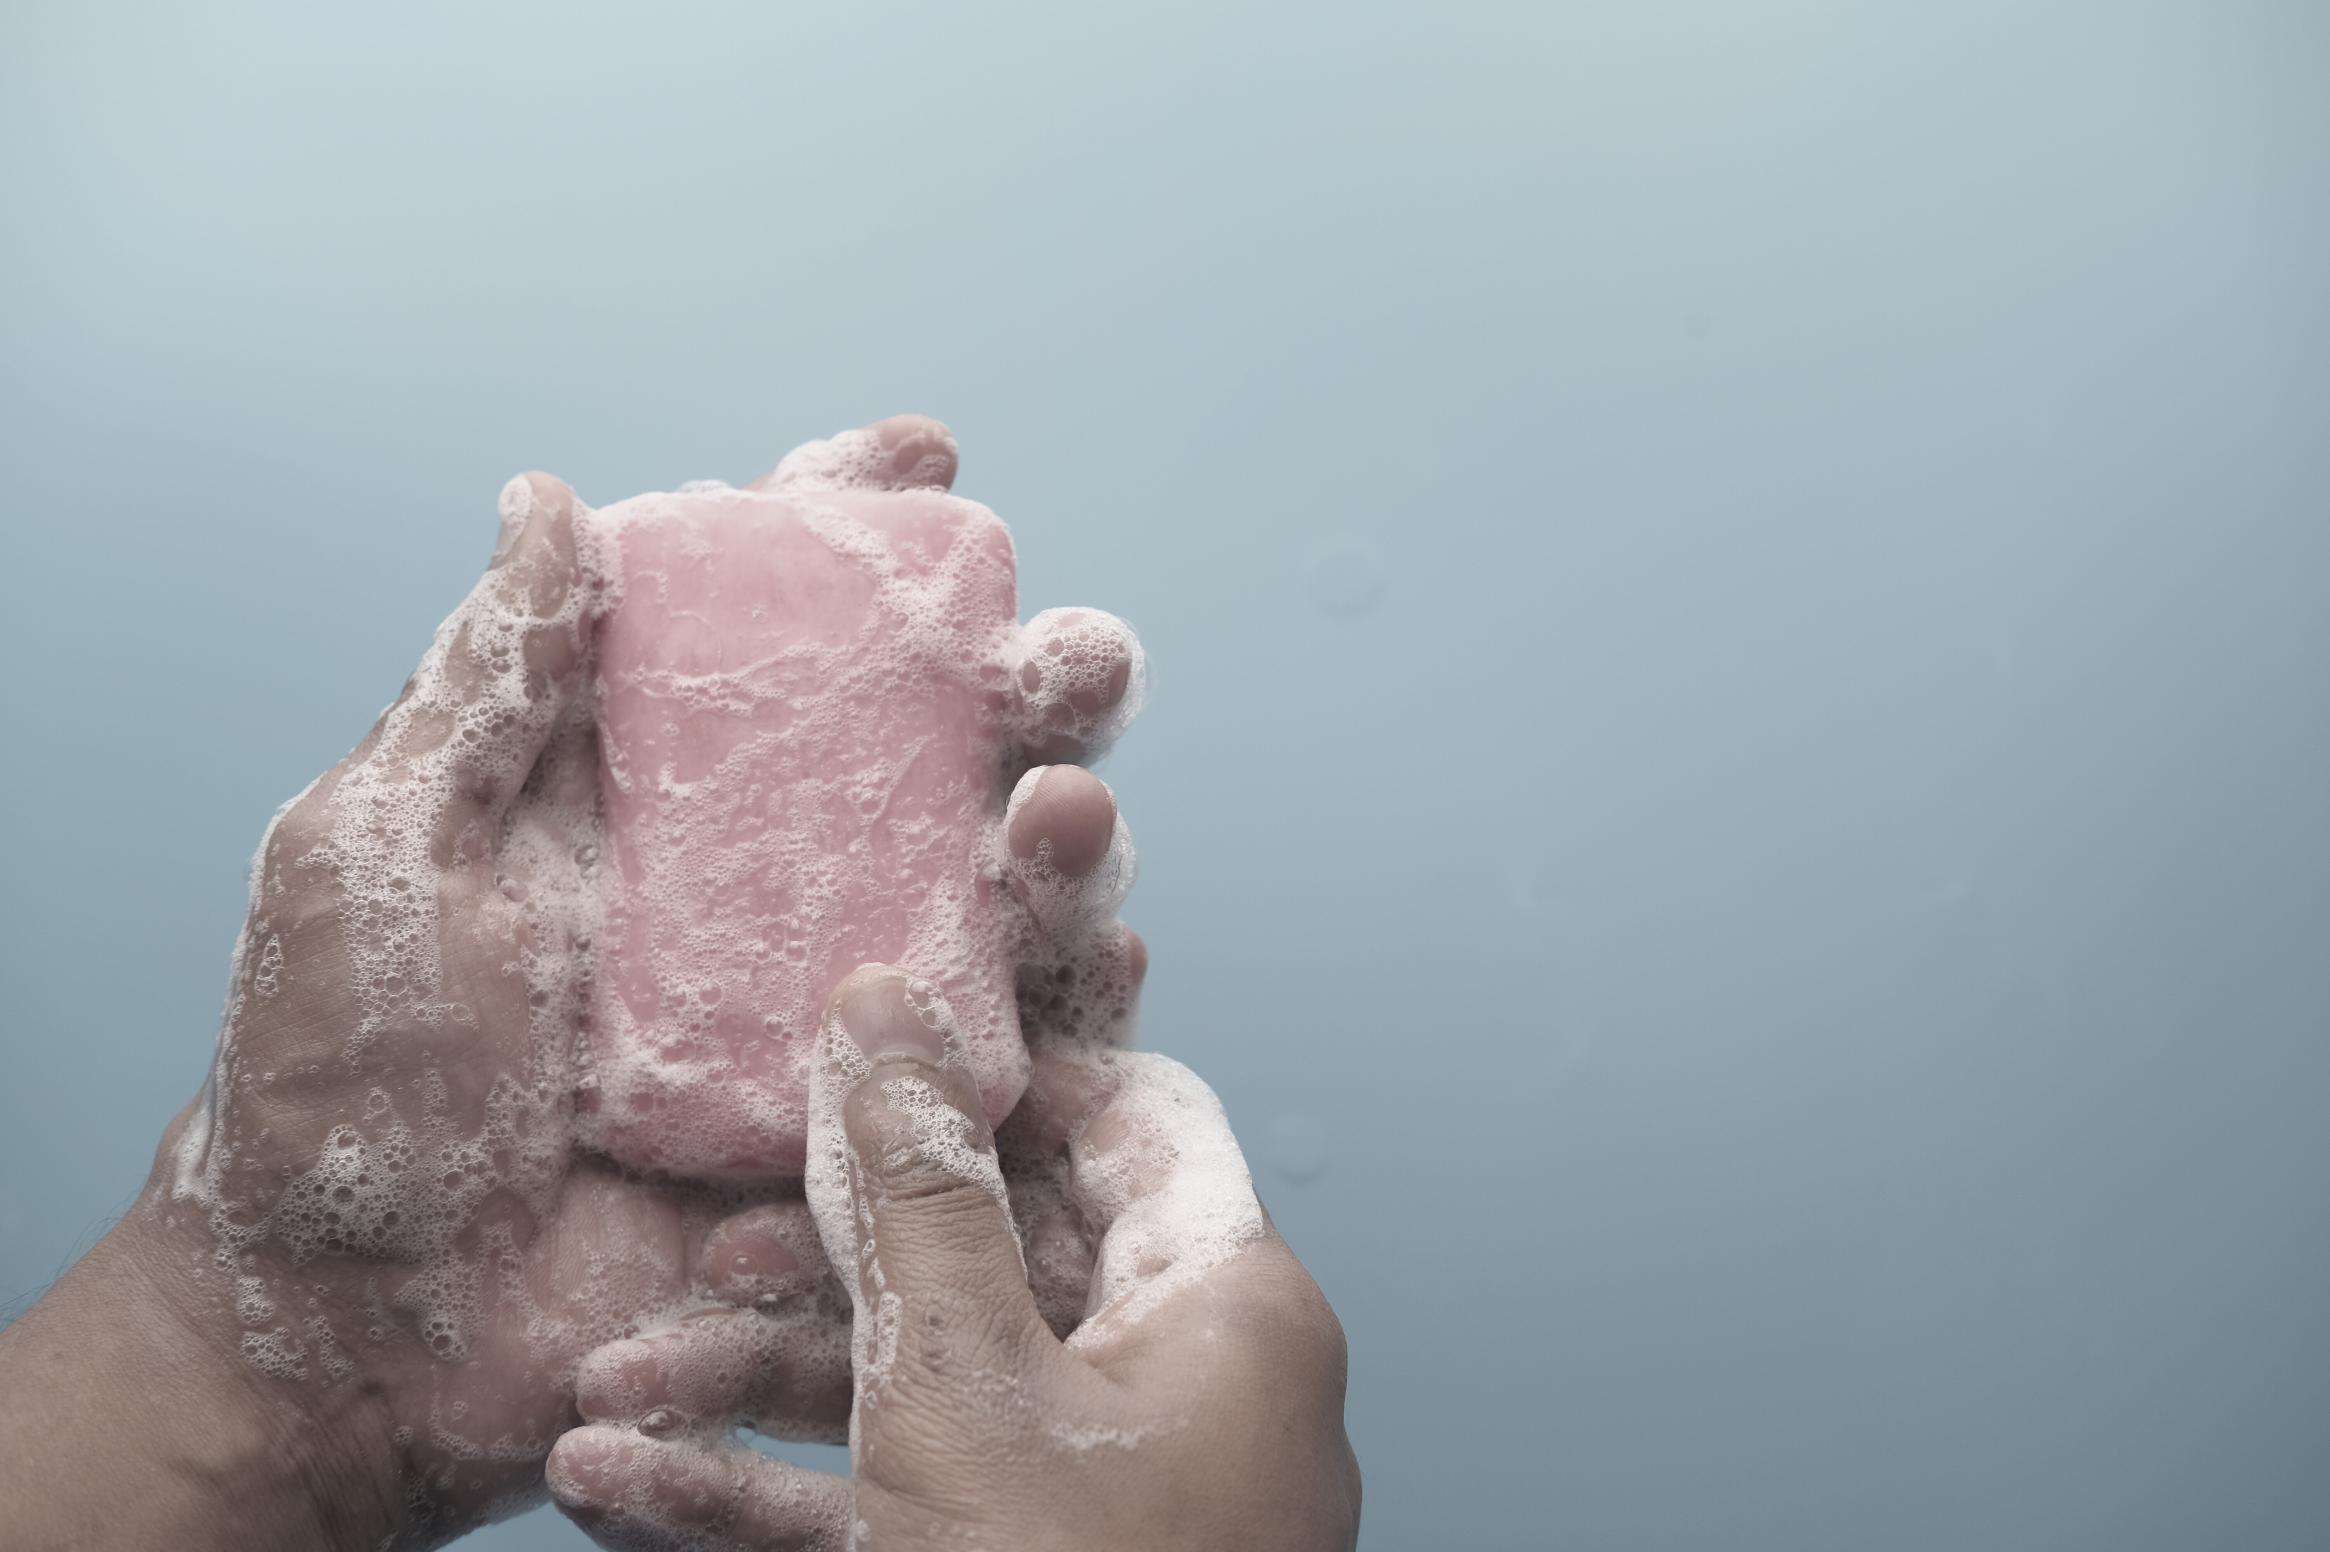
CHAPTER 7:
INDICATIONS FOR HAND WASHING
Hand washing should be performed at the following times:
Before and after patient contact
Before performing aseptic procedures
After exposure to body fluids or excretions
After touching patient surroundings
Before handling food or oral medications
Page 8

Slide 11
CHAPTER 5:
QUIZ
1. What is the minimum time recommended for hand scrubbing?
2. Name two types of hand hygiene.
3. Why is it important to dry hands completely?
4. What areas are commonly missed during hand washing?
5. When should alcohol-based hand rub be used instead of soap and water?
Page 9

Slide 12
Thank
You
PRESENTED BY GROUP 1

